Slide 1
YEA
Young Engineers In ASHRAE
2019-2020 CRC Workshop

Slide 2
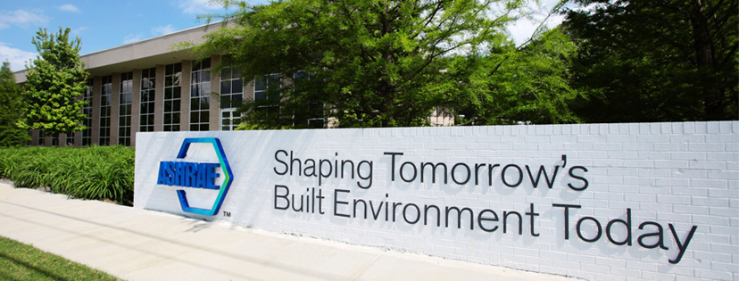
What is ASHRAE?
ASHRAE
ASHRAE, founded in 1894, is an international organization of 56,000 persons. ASHRAE fulfills its mission of advancing heating, ventilation, air conditioning and refrigeration to serve humanity and promote a sustainable world through research, standards writing, publishing and continuing education.
Our Mission: To advance the arts and sciences of heating, ventilating, air conditioning and refrigerating to serve humanity and promote a sustainable world.

Slide 3
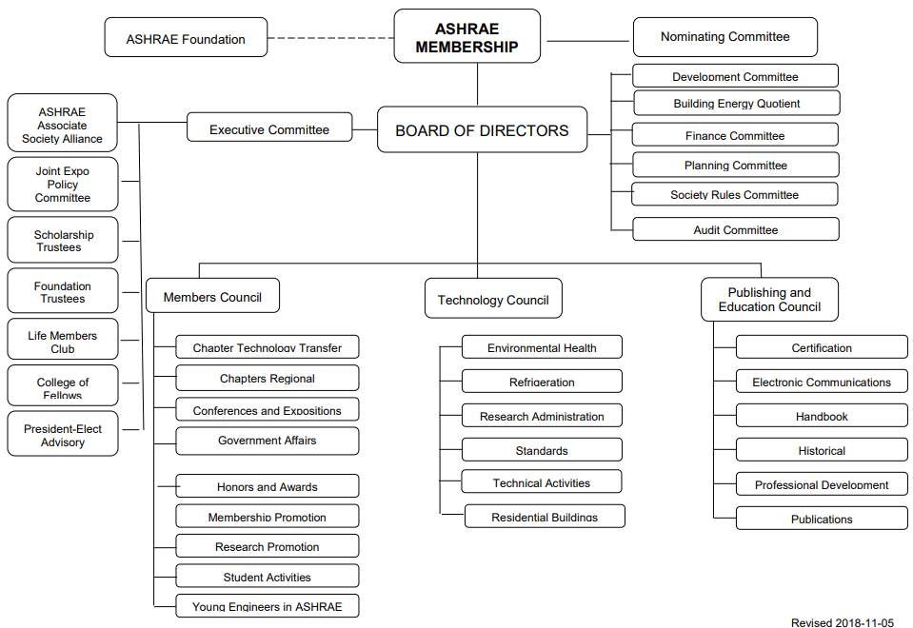
What is ASHRAE?

Slide 4
ASHRAE Acronyms...
ASHRAE
bEQ Building Energy Quotient
BOD/ExCom Board of Directors/Executive Committee
BOG Board of Governors
CIBSE Chartered Institution of Building Services Engineers
CRC Chapters Regional Conference
CTTC Chapter Technology Transfer Committee
DAL Director-at-Large
DRC Director and Regional Chair
DL Distinguished Lecturers
ISHRAE Indian or Israel SHRAE
MBO Management by Objective
MC Members Council
MOP Manual of Procedures
PAOE Presidential Award of Excellence
PDC Professional Development Committee
RAL Region-At-Large
ROB Rules of the Board
RP Research Project or Research Promotion
RVC Regional Vice Chair
SAC Student Activities Committee (or SA)
TC Technical Committee or Technology Council
TOY Too Old for YEA
YAH Young At Heart
YEA Young Engineers in ASHRAE
YRC YEA Regional Coordinator

Slide 5
YEA @ Society

Slide 6
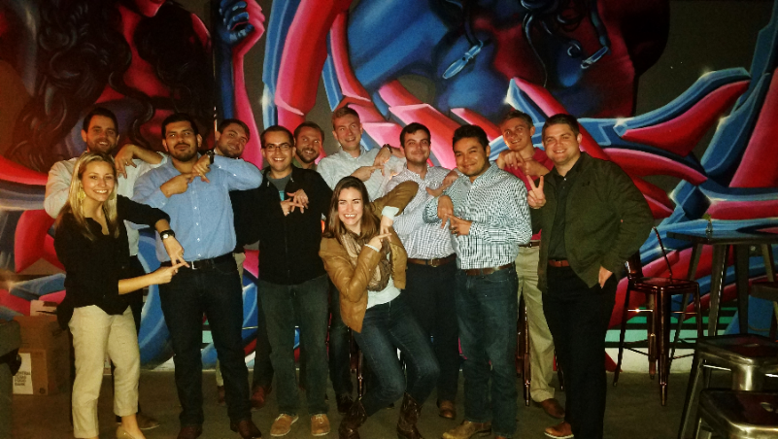
Young Engineers in ASHRAE
This is who we are. And this is what we do…
Young Engineers (35 years old and under) in ASHRAE
  Advance the arts and sciences of HVAC&R
  Serve humanity and promote a sustainable world
Aim to enhance our member benefits for young professional ASHRAE members by identifying activities and services focused on their needs.

Slide 7
Growth in YEA Numbers!
  As of March 2019, the average ASHRAE age is 46 years old.

Slide 8
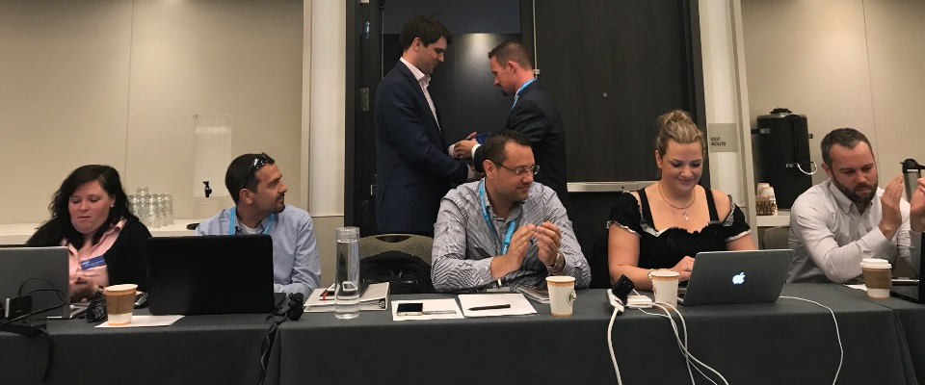
Young Engineers in ASHRAE
What and who is the YEA Committee?
Committee Chair – Vanessa Freidberg
Senior Vice Chair – Rachel Romero
Junior Vice Chair – Shona O’Dea
Regional Vice Chairs – 15 RVCs – one for each Region
At-Large Members
CIBSE Consultant
Liaison/Membership Promotion
Liaison/Student Activities
BOD Ex-Officio – Jeff Clarke
Consultant – Stephanie Kunkel
Staff Liaison – Rhiannon Masterson

Slide 9
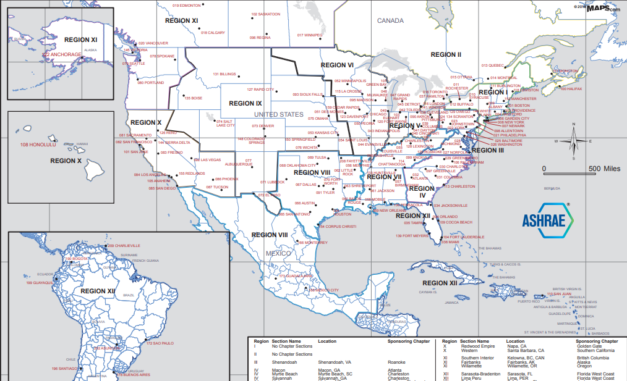
ASHRAE Map of Regions (I – XII)

Slide 10
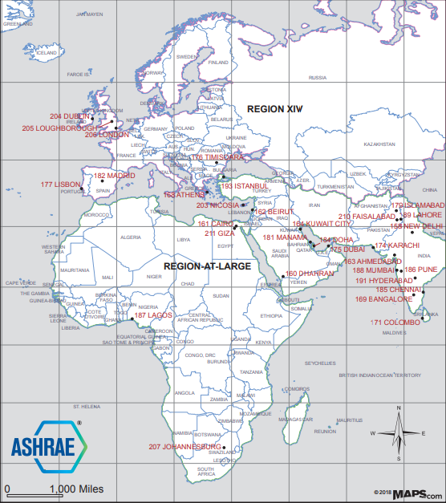
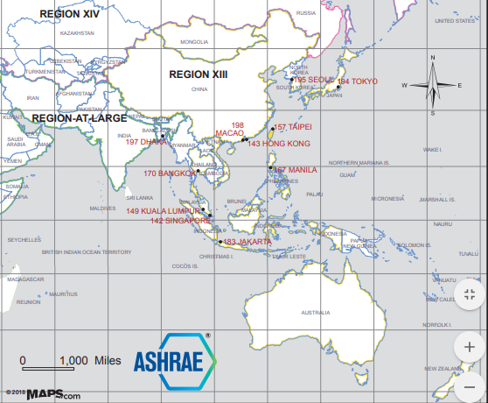
ASHRAE Map of Regions (VIII, XIV, At-Large)

Slide 11
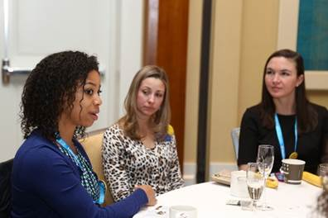
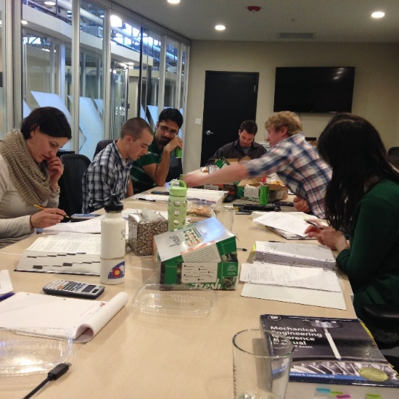
YEA RVC – YEA Regional Vice Chair
What the YEA RVC does:
  Annual and Winter Conferences
  Strengthen relationships with Chapter, Region and Society leadership
  Participate in Regional planning meeting
  Lead YEA session at chapter president’s training
  Attend Chapter Regional Conference (CRC)
    Present at business meeting
    Host YEA training workshop
  Subcommittee responsibilities

Slide 12
YEA Subcommittees
Professional Development
Developing Leader Award
HVAC Design Training Scholarship
Personal Development
YEA Leadership Weekend
Leadership U & LeaDRS
Technical Committees
Conference Networking Event
Student Retention
Liaison Coordination
PDC/YEA Training Products
YEA Leadership Weekend 2.0
First Time at an ASHRAE Conference Seminar
Chapter/Member Outreach
CRC PowerPoint Updates
Outreach Development
YEA Leadership International
RAL/Region XIII & XIV Outreach
Resource Connections
College of Fellows Mentorship

Slide 13
Regional YEA Statistics
Chapter Name | YEA Members 2016 | YEA Members 2017 | YEA Increase | % YEA Increase | Total Members | % of Total Membership
Region IV Total | 452 | 464 | 12 | 2.7% | 2,619 | 17.7%
Atlanta | 198 | 205 | 7 | 3.5% | 1,006 | 20.4%
Charleston | 27 | 24 | -3 | -11.1% | 140 | 17.1%
Greenville | 20 | 18 | -2 | -10.0% | 179 | 10.1%
Noth Piedmont | 24 | 19 | -5 | -20.8% | 359 | 5.3%
South Carolina | 18 | 21 | 3 | 16.7% | 137 | 15.3%
Southern Piedmont | 75 | 85 | 10 | 13.3% | 359 | 23.7%
Triangle | 90 | 92 | 2 | 2.2% | 439 | 21.0%
Sample – use your region’s data here

Slide 14
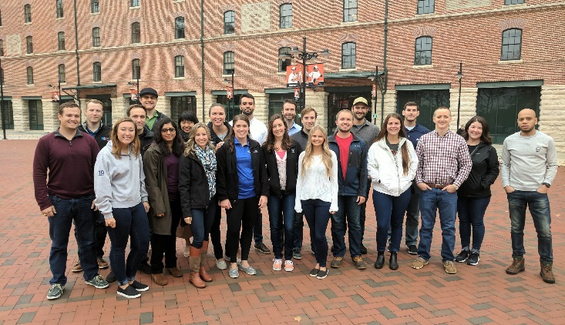
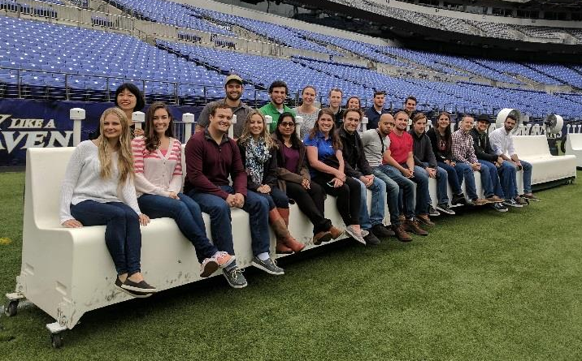
Programs, Awards & Resources of YEA
  YEA provides a variety of education and networking programs tailored to members’ specific needs:
    YEA Leadership Weekend & Leadership International
    YEA Leadership Weekend 2.0
    SmartStart Program
    Social/Networking Events at Society Meetings
    Leadership U/LeaDRS
    Developing Leader Award
    YEA Award of Individual Excellence
    Graduate Student Travel Award
    HVAC Design Essential Scholarship
    YEA Connections Newsletter, YEA Society Website, Facebook Page
    Technical Committees Guide
    Young Members Guide

Slide 15
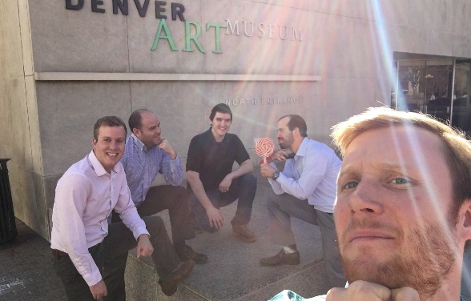
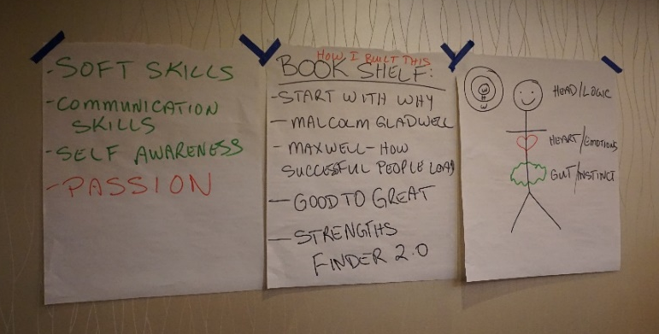
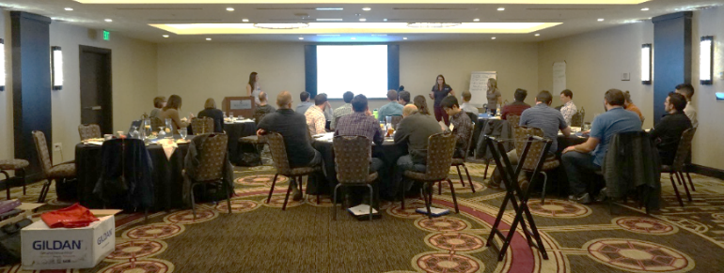
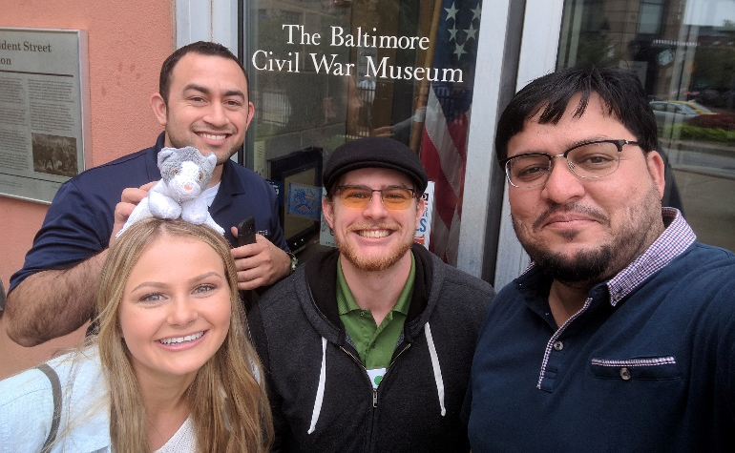
YEA Leadership Weekend (YLW)
YEA Leadership Weekend is an opportunity for future leaders of ASHRAE to develop soft skills and network with other young professionals.
  Understand your own and other’s personalities
  Develop leadership skills and tools
  Explore team dynamics
  Broaden and refine existing communication techniques
Objectives of leadership weekend are:
  Growth through learning
  Leadership, networking, communication, and professional development
Held twice per year:
  Fall (East Coast); Spring (West Coast)
Register at www.ashrae.org/YLW

Slide 16
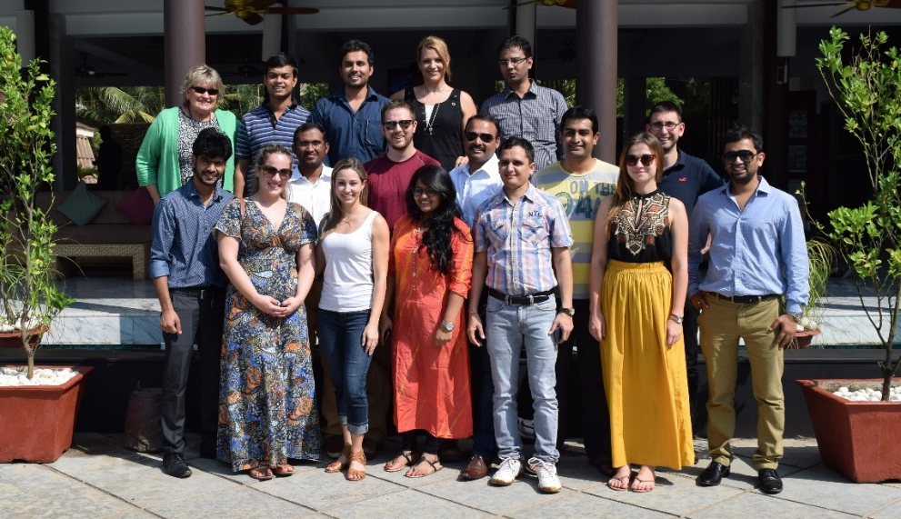
YEA Leadership International (YLI)
YLI has the same goals as YLW, which is to act as an opportunity for future leaders of ASHRAE to learn more about Society, develop soft skills and network with other young professionals.
Event has been held in Sri Lanka, Dubai, Kuala Lumpur, India, Greece, Hong Kong, and Serbia.
Objectives of leadership weekend are:
  Leadership, Networking, Communication, Professional Development
More information & registration www.ashrae.org/YLI

Slide 17
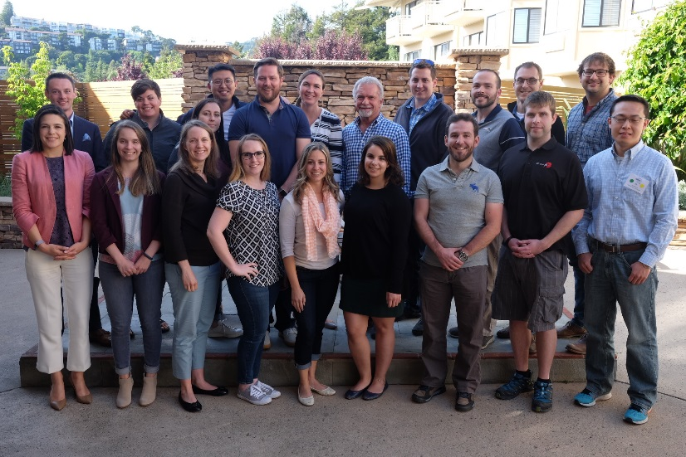
YEA Leadership Weekend 2.0 (YLW 2.0)
Continuation of YLW and designed to provide advanced training resources to YLW alumni
Limited to 20 attendees. Requirements:
  Current ASHRAE member (No Age Requirement, 35+)
  Previous YLW or YLI attendance
Ralph Kison as facilitator to expound on soft skills and development strategies.
This event sells out quickly!
Learn more at www.ashrae.org/YLW2.0

Slide 18
SmartStart Program
Allows student members to transfer to Associate membership after graduation for discounted rate.
Basic Rate
  First year is $21, second year is $85, and third year is $110 = $216 for 3 years
  Save over $400!
Developing Economy Rates
  First year is $15, second year is $45, and third year is $55.
  A member qualifies for the Developing Economy rate if their country of residence is classified as a low or lower-middle income economy by the World Bank.
Associate membership provides access to all ASHRAE member benefits
ASHRAE Student members who joined at least one year ago are eligible to transfer using the SmartStart program.
www.ashrae.org/SmartStart

Slide 19
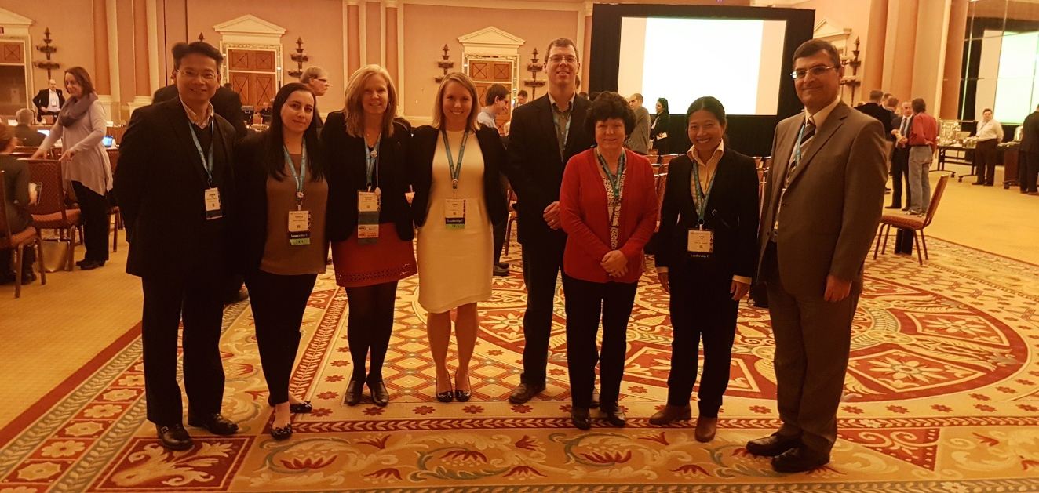
Leadership U
Up to four YEA members are selected to shadow one of the four ASHRAE VPs at an ASHRAE Winter or Annual Conference.
  Candidates selected via application process.
  Winners matched up with an ASHRAE VP to participate in all of their events and meetings, including social activities
  Candidates will document their experiences and present them to the YEA Committee, their Chapter, and their Region
More information can be found at www.ashrae.org/LeadershipU

Slide 20
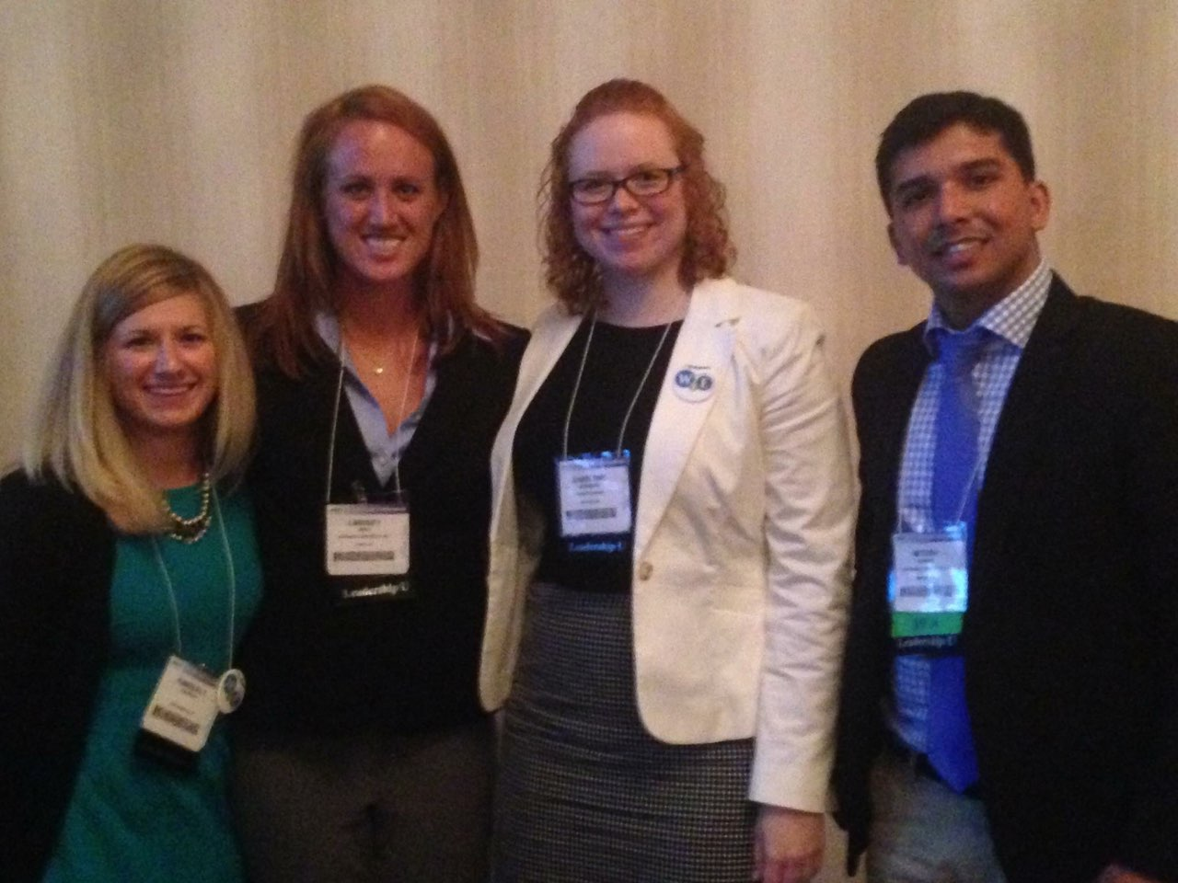
LeaDRS
LeaDRS Program (Leadership Development through Regional Support)
Shadow Director Regional Chair (DRC) during an ASHRAE conference.
Operated at the Regional level. Check with your Region for information regarding applications and deadlines.

Slide 21
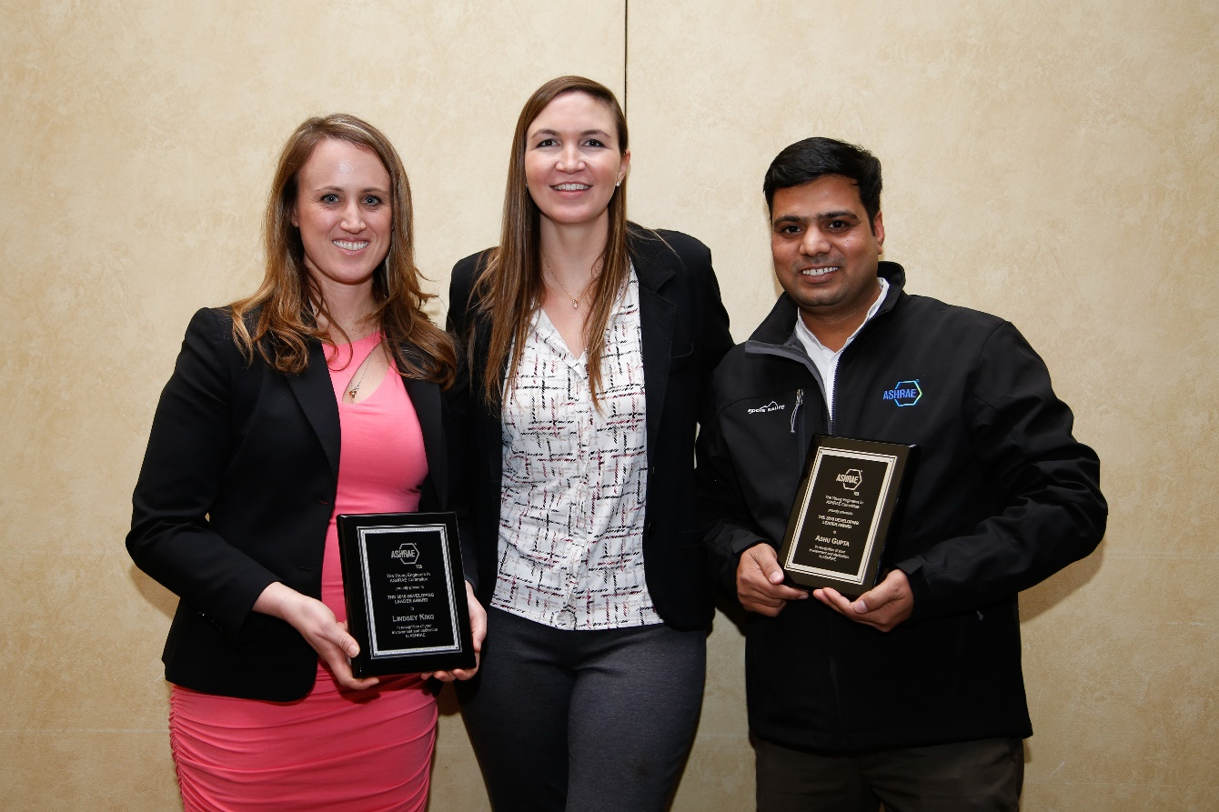
Developing Leader Award
Designed to recognize those members who started their involvement as soon as they joined ASHRAE
Points-based award
Learn more at YEA Developing Leader Award

Slide 22
YEA Award of Individual Excellence
Outreach Category:
  Personally promoted YEA
  Contributed directly to the overall growth and development of YEA
Personal Development Category:
  Assisted in the planning/organization of at least two (2) YEA oriented activities
  Attended a previous YEA Leadership Weekend (YLW)
Professional Development Category:
  Participated on at least one (1) ASHRAE Technical or Standards Committee
  Attended an ASHRAE educational course or training
Learn more at YEA Award

Slide 23
Graduate Student Travel Award
Operated by the College of Fellows
Chapters and Student Chapters can nominate a Ph.D. graduate student (within 2 years after graduation)
Fellow Fund will sponsor the recipient to attend two concurrent society meetings and an ASHRAE Fellow will act as guide to tech program

Slide 24

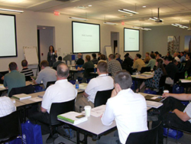
HVAC Design Training Scholarship
What: HVAC Design: Level I – Essentials training allows attendees to gain the fundamentals & technical aspects to design, install and maintain HVAC systems.
Scholarship: Funds the full cost of registration for (5) applicants/round with (2) rounds/year. Any additional costs not covered (transportation, hotel, etc).
Criteria: All applicants must be ASHRAE members and 35 years of age or younger as of July 1 of that society year. Student members are not eligible. Applicants will be reviewed based on contribution to the industry, ASHRAE involvement and career goals.
Round 1: Application open May – June ; Training July – December
Round 2: Application open November – December ; Training January – June

Slide 25
ASHRAE Technical Committees (TC)
OPEN TO EVERYONE!
Currently 93 TCs that meet at conference
Group of volunteers who provide the Society with expertise in a specific field or subject.
Technical Committees:
  Long-lived committees
  Develop Research Projects
  Develop programs for the Technical Conference
  Oversee handbook chapters
Attend
Introduce Yourself
Get Involved
Learn more in The Young Member's Guide to Getting Involved in Technical Committees
Notes:
There are currently 93 TCs organized into 10 sections. Each TC has a defined scope and is numbered and named.
Examples are: TC 7.1 Integrated Building Design and TC 9.1 Large Building Air Conditioning
TCs are formally structured with a chair, vice-chair, secretary, sub-committee chairs, liaisons, sub-committee members, and other specialized assignments (such as Webmaster). TC members are designated as Voting Members and non-voting members (who may include Corresponding Members and Provisional Corresponding Members). The role of liaison is to connect TCs to other elements within ASHRAE and to external organizations.
TCs meet twice a year (at the Winter and Summer ASHRAE meetings).

Slide 26
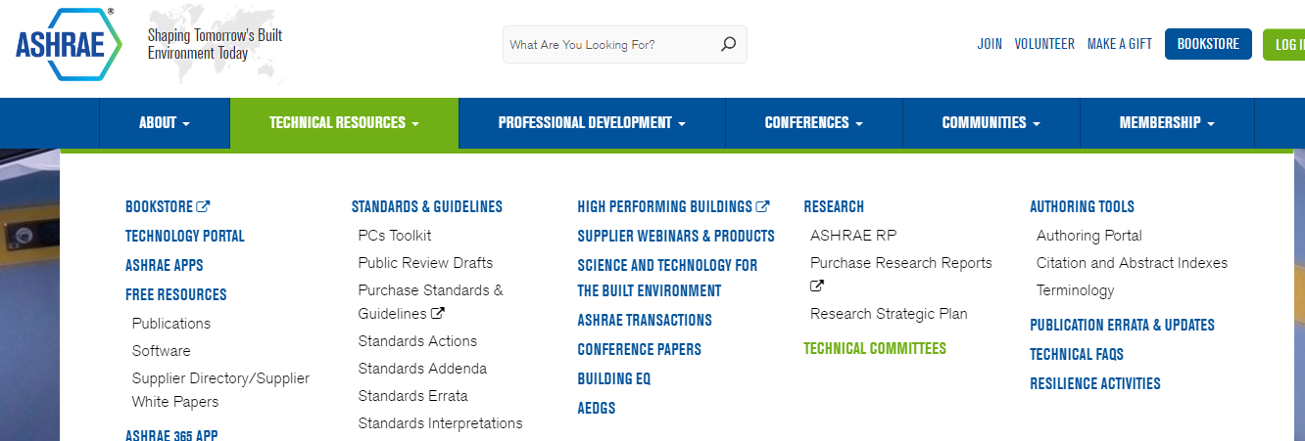
ASHRAE Technical Committees (TC)
Cruise the ASHRAE home page and see what the TCs are doing
    View complete list of TCs with scopes
    E-mail the secretary or chair about your interest
    Apply for provisional corresponding membership directly with ASHRAE
Stay involved and connected
Most work occurs in the subcommittee
Non-voting members can chair subcommittees
Notes:
Show how to navigate to TC webpage-
Select the Technical Resources menu on the ASHRAE homepage, then select Technical Committees from the left-hand menu list for full information on all ASHRAE TCs, TGs, TRGs, and MTGs. The websites maintained by the individual TCs are a great place to find out more about what a TC is actually doing and who to contact to get involved.
A bit of information regarding Provisional Corresponding Members, and how they differ from Corresponding Members:
Provisional Corresponding Members are temporary additions to the TC/TG/TRG roster made by ASHRAE staff between roster update cycles, usually at the request of someone wanting to participate in the technical committee. If the technical committee chair takes no action on a Provisional Corresponding Member, they are dropped from the roster after two years. For purposes of committee assignments and other work of the TC/TG/TRG committee, the status of “Provisional” should not limit an individual’s active involvement in the work of the TC/TG/TRG. To apply: e-mail MORTS@ashrae.net
Corresponding Members are expected to participate in TC/TG/TRG activities and attend meetings when possible, but may not vote on TC/TG/TRG business. They may, however, serve on and chair TC/TG/TRG subcommittees, including Proposal Evaluation and Project Monitoring Subcommittees, and may vote at the subcommittee level. A Corresponding Member may also serve as Vice Chair or Secretary of a TC/TG/TRG if he/she attends meetings regularly.

Slide 27
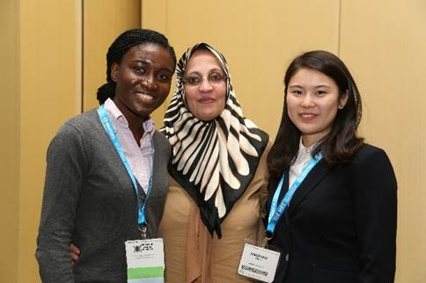
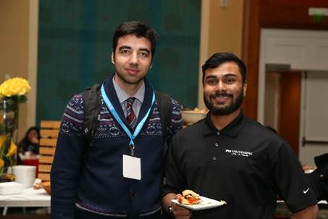
Networking/Information Exchange
Social/Networking Events at Society Meetings
  Hospitality Suite at all Society meetings
YEA Page on Society Website
  Useful links for resources, events, technical information
YEA Connection Newsletter
  Quarterly publication geared towards young membership
Facebook Page
  Find other local YEA members, network, updates on events & ASHRAE related news

Slide 28

YEA Connections Newsletter
Read the YEA Connection
Subscribe
Click here to submit an article

Slide 29



How to follow YEA
  Facebook group:
  www.facebook.com/ashraeYEA/
  LinkedIn group:
  www.linkedin.com/groups/2026718
  ASHRAE website:
  www.ashrae.org/YEA

Slide 30
YEA Guides
How to Join a Technical Committee
https://www.ashrae.org/File%20Library/docLib/YEA/YEA-TC-Guide-2012.pdf
Young Member Guide
https://www.ashrae.org/membership--conferences/young-engineers-in-ashrae

Slide 31
YEA @ Chapters

Slide 32
YEA Chapter Chair (YCC)
What YCCs Do:
  Grow YEA membership in your chapter
  Plan chapter technical or social events
  Post articles about YEA activities in your chapter & society newsletter/website
  Promote society programs
  Facilitate mentee and mentor connection
  Establish YEA chapter budget – events, program sponsorship (ex YLW)
  Coordinate with Student Activities and Membership Promotion Chairs
  Track YEA PAOE points for your chapter
  Attend CRC YEA Workshop
  Send updates to YEA RVC & attend any scheduled conference calls
    What is your next activity? How did your last activity go (participants, cost, location, success level)? Mentorship program update. What do you need in terms of support from your YRC? How many YEA PAOE pts have you earned?

Slide 33
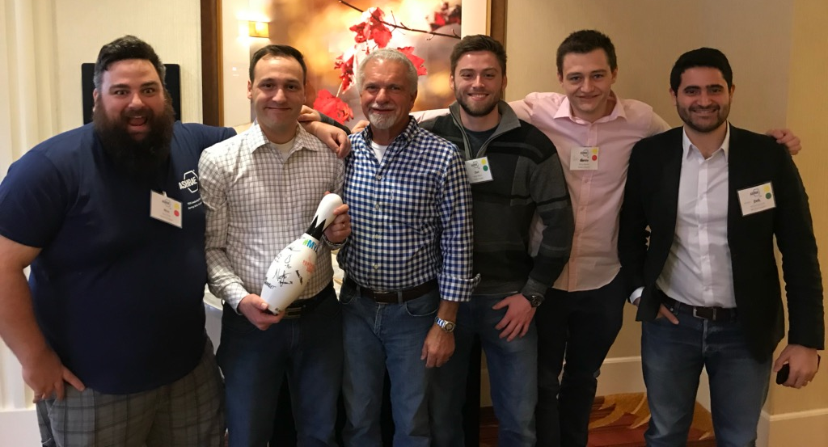
Chapter Chair – Best Practices
Passion sells better than just the product
Get help from people around you – create a team for succession planning
Direct contact still works, use it – make some personal calls or texts
Mix types of events (technical, educational, tour, teams, meetup)
Know your ASHRAE Society programs

Slide 34
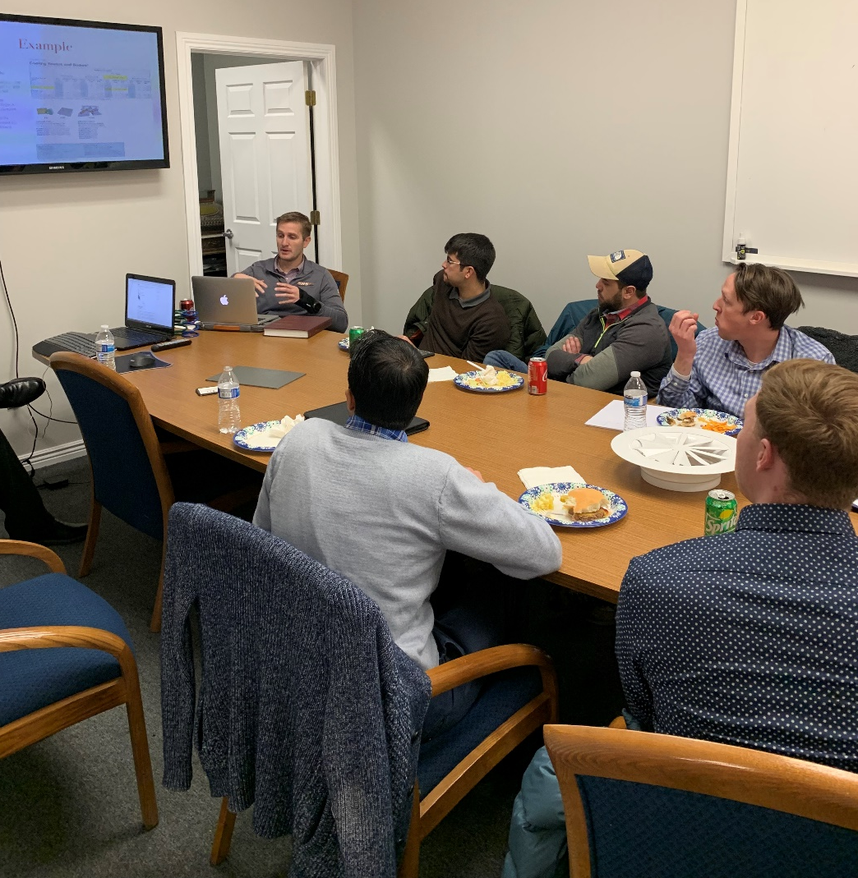
Chapter Chair – Best Practices
Work closely with Membership Promotion & Student Activity chairs
Document your work (event dates, contacts, budget, participation, and constructive criticism), this will help with future YCC transition.
Take pictures and write a short wrap-up of your events for communication. If you don’t talk about it, no one will know.
Introduce new people to your group, help create a smooth transition.
Ask for feedback on your events.

Slide 35
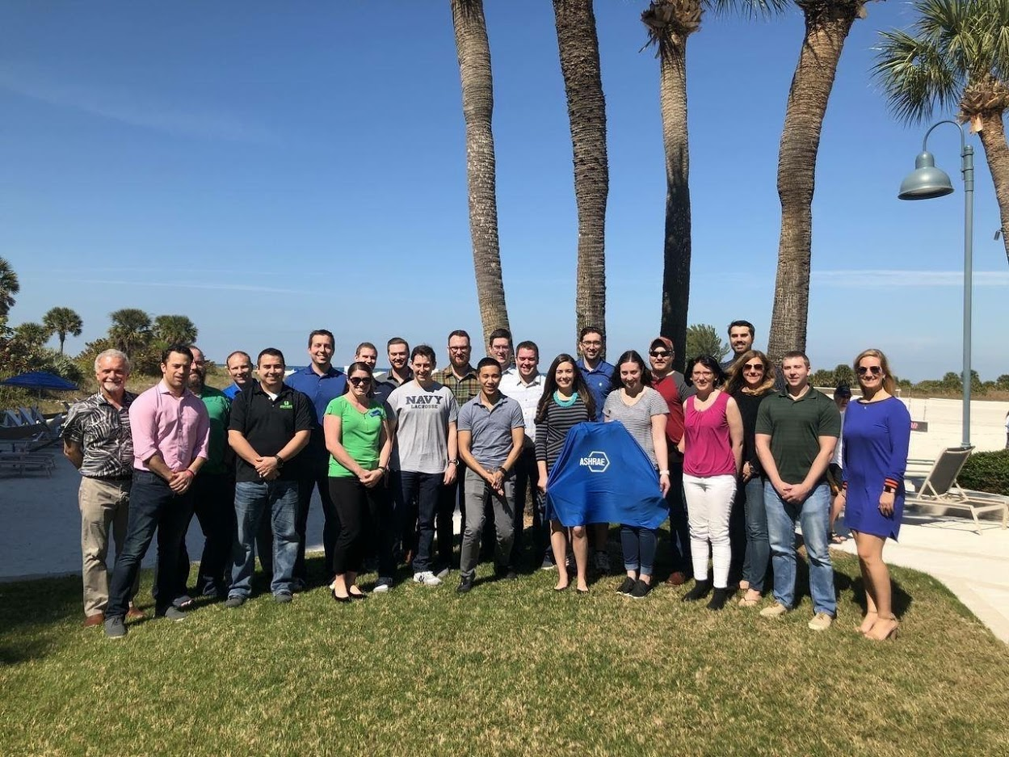
Get Involved in Your Chapter
Being a member of ASHRAE does not only include going to the Society events, there are chapters supporting local members all over the world.
Look up your chapter website and register for chapter event calendar (or just Google it).
Introduce yourself to your YEA Chapter Chair
Ask to help at your local meetings, talk to your chapter Board of Governors (BOG)

Slide 36
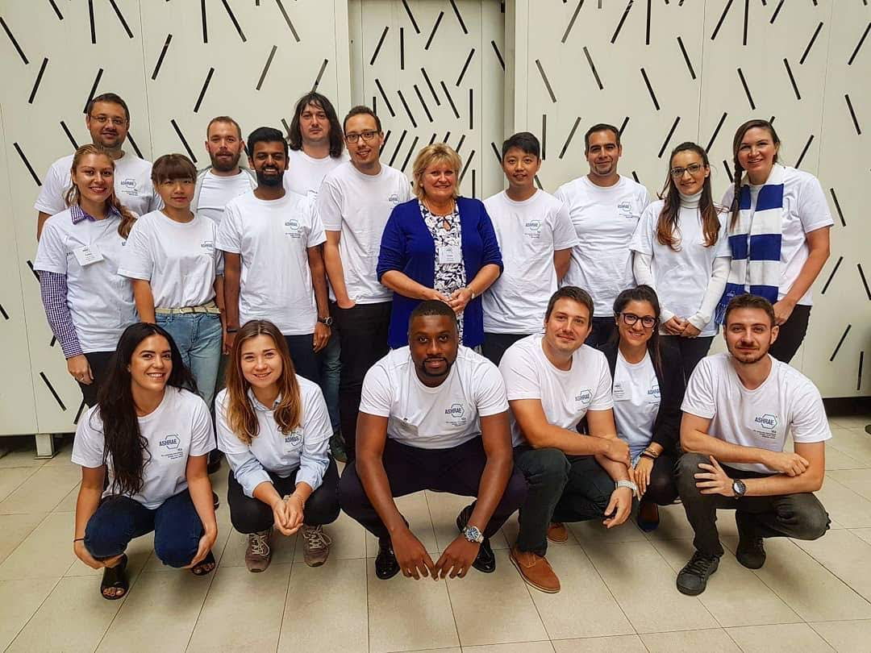
Get Involved in Your Chapter
Be part of the team! Ask to be listed as a volunteer if all positions are filled.
Organizing events helps you develop key leadership and soft skills, which will bring your leadership skills to a new level. Be part of the success.
New people = new ideas. Just because something has never been done does not mean it will not work. Bring those ideas!
What will you get? Fun, friendship, leadership skills, professional development, and networking opportunities. Invest in yourself and join your local chapter now.

Slide 37
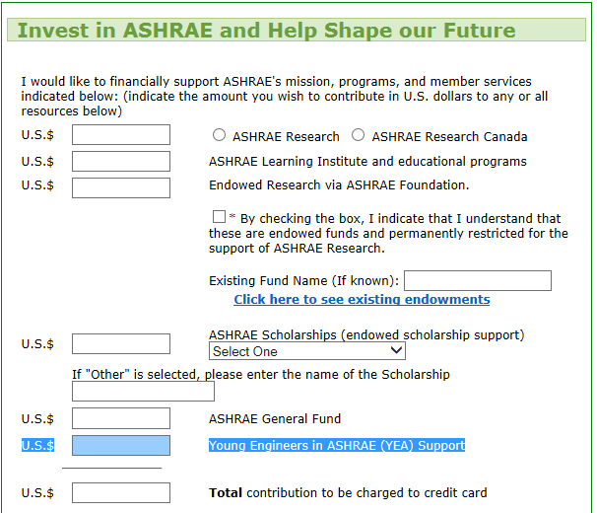
Support Young Engineers in ASHRAE

Slide 38
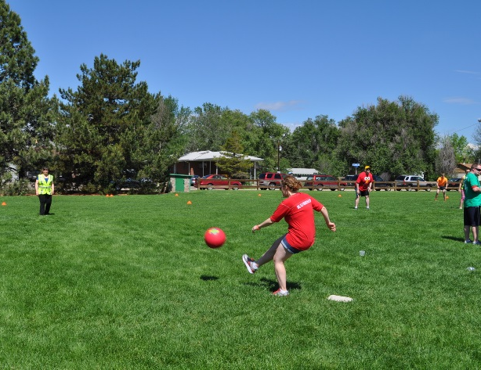
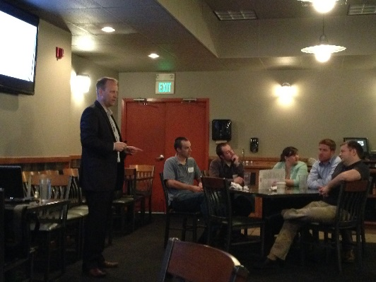
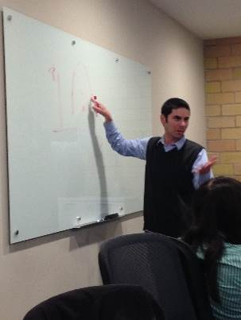
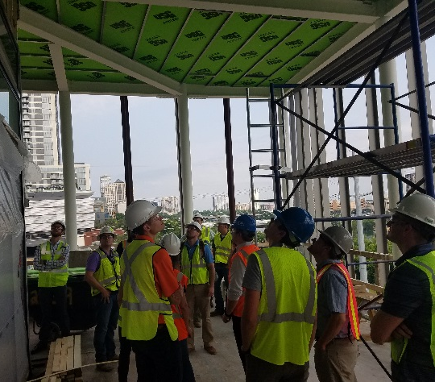
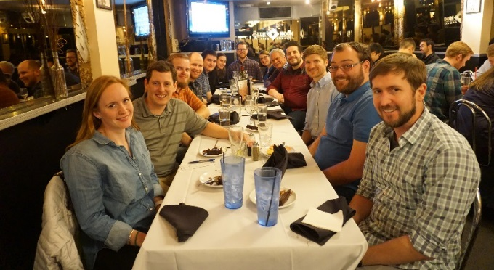
Target YEA Membership
Student members!
  Our biggest challenge is low retention of student members. Make this a priority! Coordinate with your Student Activities Chair.
New hires in the industry (engineers, contractors, vendors)
Co-workers who are 35 and under
Run a YEA membership report for your chapter
Target current YEA members not involved. Figure out why and get them involved!

Slide 39
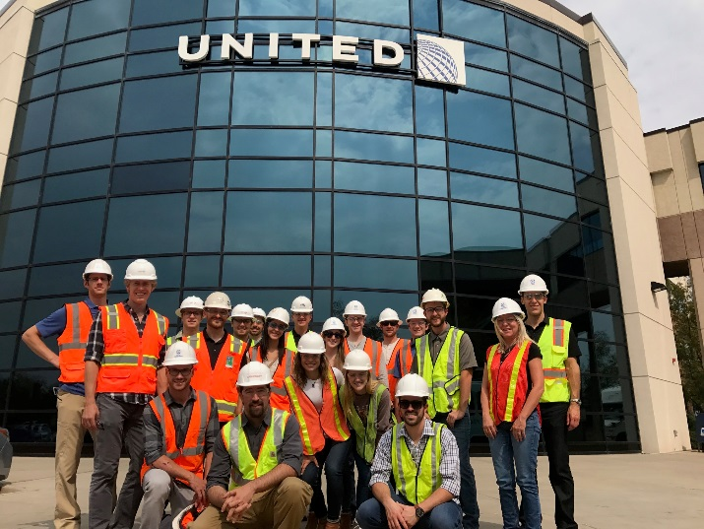
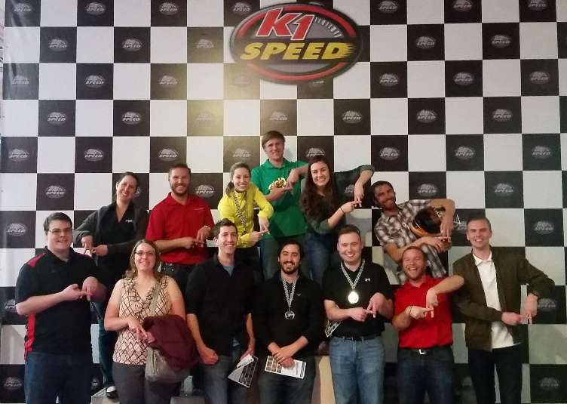
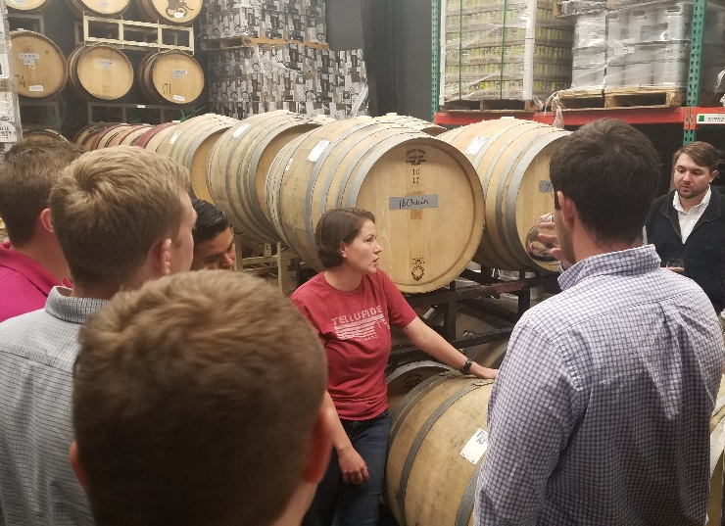
YEA Chapter Activities Ideas
Technical Tours
  Breweries, stadiums, fabrication shops, labs, manufacturing plants, etc.
Sporting events/tailgate parties
Bowling
Sports Tournaments (volleyball, bocce ball, kick-ball, etc.)
Happy Hour
HVAC Essentials/101 Tech Sessions
Visit Intro engineering Classes with Student Activities
PE Study Sessions
Be creative!

Slide 40

Have an event?
Take pictures
Submit a summary to youngengineers@ashrae.org
Have published on ASHRAE webpage, YEA Connections, or YEA Facebook

Slide 41
YEA @ Work:
Reports, PAOE, & MBOs

Slide 42
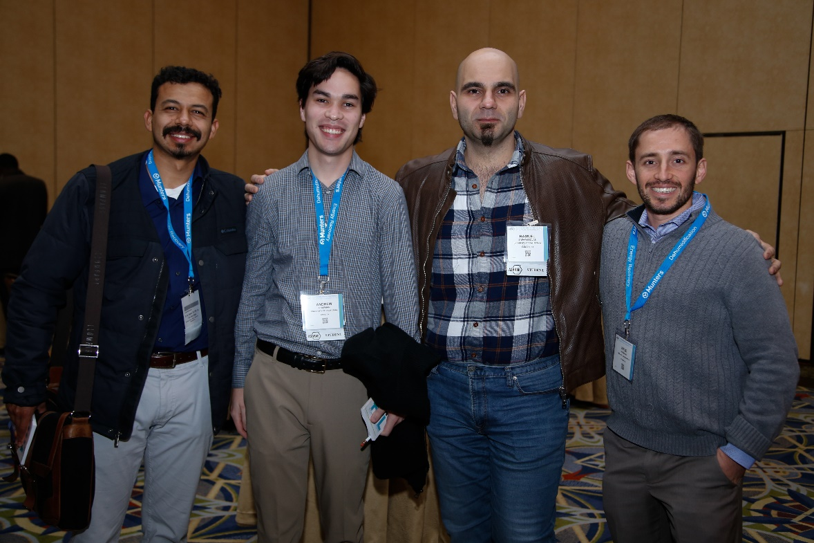
Running Chapter Reports
YEA Chairs have access to reports to run YEA data.
Why is this information important to me?
  Know what YEA members are in your chapter for contacting
  Know how many are in your chapter

Slide 43
Running Chapter Reports
Things to remember:
  The reports include personal data for members and should be kept in a secure place.
  The reports should not be posted in a place accessible to the general public.
  The data should only be used for ASHRAE purposes.
  The data provided is what was provided by the member and may not always be current.

Slide 44
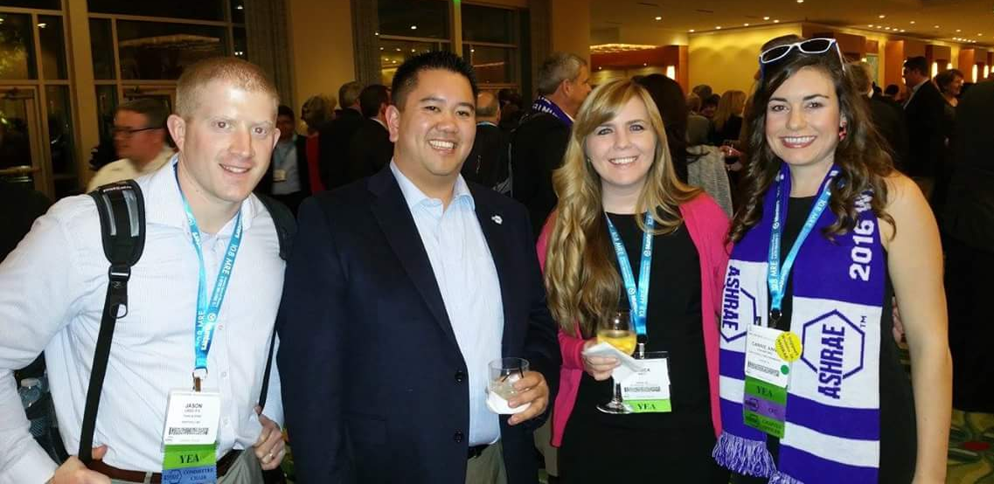
Presidential Award of Excellence Points
PAOE = Presidential Award of Excellence
Society President selects point assignments annually
  Dynamically changing. Submit your feedback to your RVC.
Starting July 1, 2019, YEA now has it’s own PAOE category!

Slide 45
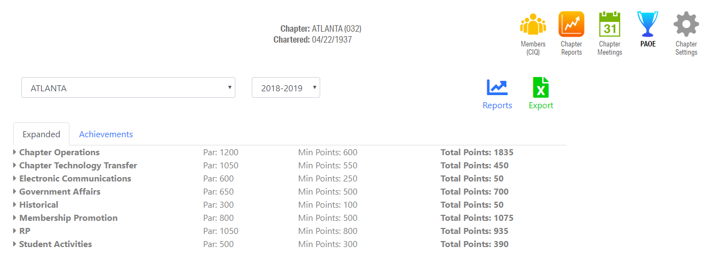
PAOE
Reporting is done online at www.ashrae.org in the chapter activity section
  A collection of tasks with associated point values
  A means of recognition for the work you have done
  A quality improvement tool - a way to measure your progress
  Minimum score is 300 points for a chapter to achieve PAOE
  PAR is 500 points to achieve STAR Award, Honor Roll, or Premiere
Notes:
Show them how to log into the system, and enter PAOE points.

Slide 46
Management by Objective
What are MBO’s (MCO Appendix 8A)
  Objectives or Goals
  Written
  Measureable
  Attainable
  Challenging
  Understandable
  Agreed Upon
  Costed
  Timed
Why are they important

Slide 47
Action Planning: Management by Objectives (MBO)
Goal
  What you want to be, do or attain?
Action Item
  What specifically will you do to accomplish this?
Who/When
  Plan for the persons who can help you, and establish a time frame for getting the task/s completed
Status
  Measurement of progress of attaining the goal(s)

Slide 48
Chapter Operations
Why is YEA as important as
  Membership
  Resource Promotion
  Chapter Technology Transfer
How does this tie into your chapter?
What do you need to do for your chapter?
  The Manual for Chapter Operations
    https://www.ashrae.org/society-groups/chapters/manual-for-chapter-operations
Notes:
Describe that the goal of SA is to create interested in HVAC, but to also create new ASHRAE Members.
Students Transferring to Full Member increases our membership numbers
More members generate more RP money
As a technical society the more members we have, the more people we can pull from for tech committees and to share technical information

Slide 49
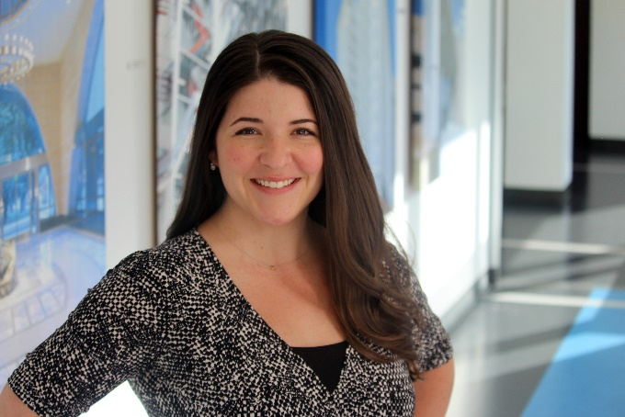
Young Engineers in ASHRAE
YEA RVC:
  Name
  Email
  Phone
ASHRAE YEA Staff Liaison:
  Rhiannon Masterson
  rmasterson@ashrae.org

